Slide 1




BEFORE THE LESSON · HOME TASK · 10 MINUTES
Geometric Sequences
and Series
Multiply by the same number each step, then add the results with one formula
Why you are doing this: we start the lesson with an 8-question Wayground check. This page tells you exactly what it will ask, so you can walk in ready instead of guessing.
Mr Malek Thiab | Grade 11 | Lesson 6-7 | Week 8 · Semester 1, 2026–27
HSA.SSE.B.4 · HSF.IF.A.3 · HSF.BF.A.2 · HSF.LE.A.2
FAITH, RIGHTEOUSNESS AND WISDOM
Mr Malek Thiab · Page 1 of 4
Notes:
Speaker notes: Send this pre-session before Lesson 6-7. Four slides: cover, the one idea with a video, one worked example, a four-question readiness check. Verbal misconceptions: students think the video replaces the examples; remind them the check is ungraded. Adaptive routing: collect the LMS answers before class and open Diagnose on the least secure question.

Slide 2



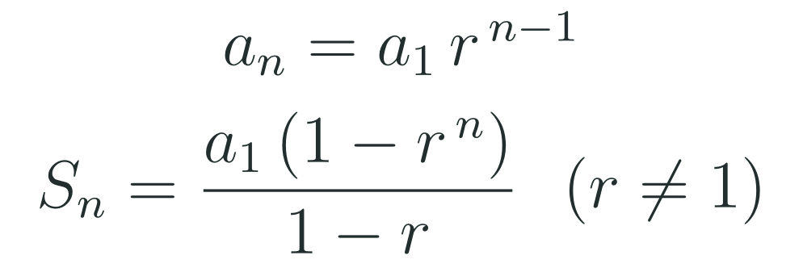
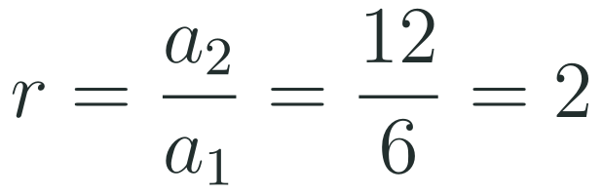
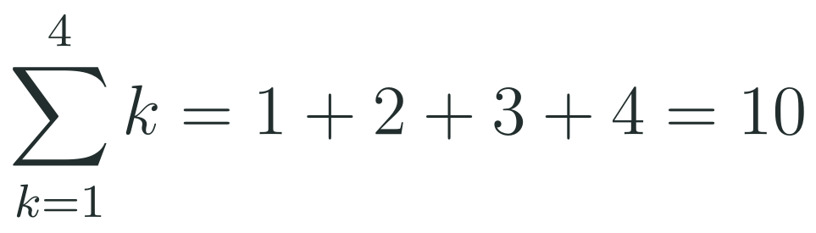

WATCH FIRST · VIDEO
Multiply by the Same Number, Every Step
A geometric sequence has a common ratio; a geometric series adds its terms
YOUR VIDEO · YOUTUBE
THE ONE IDEA
What Are Geometric Sequences and Series?
In a geometric sequence every term is the one before it times the same common ratio. That gives a direct formula for any term, and when the ratio is not 1 the sum of the first terms has a closed formula too.
Channel: The Organic Chemistry Tutor
https://www.youtube.com/watch?v=zRKZ0-kOUZM
Watch the parts on the common ratio, the nth term and the sum of a finite series.
Exponent rules
Common ratio
Sigma notation
Do the power first, then multiply.
Divide a term by the term before it.
Add the summand for each index value, from the starting index to the ending index.
HSA.SSE.B.4 · HSF.IF.A.3 · HSF.BF.A.2 · HSF.LE.A.2
FAITH, RIGHTEOUSNESS AND WISDOM
Mr Malek Thiab · Page 2 of 4
Notes:
Speaker notes: Video: What Are Geometric Sequences and Series? by The Organic Chemistry Tutor, https://www.youtube.com/watch?v=zRKZ0-kOUZM. Title and channel were confirmed through third-party mirrors; the YouTube page itself could not be opened from the build machine, so open the link once before sending. The one idea: a geometric sequence multiplies by the same common ratio r; the nth term is a one times r to the power n minus one; the sum of the first n terms is a one times (one minus r to the power n) over (one minus r), for r not equal to one. Three priors: (1) 5 times 3 to the power 4 is 5 times 81 = 405, power first. (2) r = 12 / 6 = 2, divide a term by the one before. (3) the sigma sum of k from 1 to 4 is 1+2+3+4 = 10. Verbal misconceptions: (5 times 3) to the power 4 = 50 625; subtracting terms to find r; treating sigma as one term. Adaptive routing: if most students cannot say what r is in words, open Diagnose by contrasting 7, 11, 15 with 3, 6, 12.

Slide 3
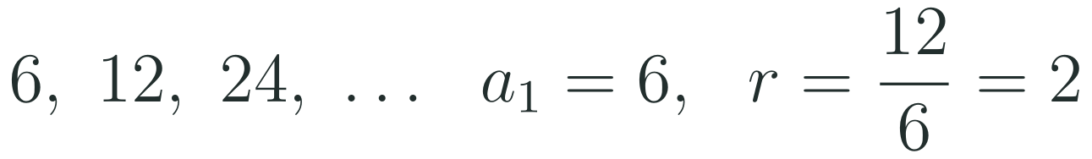
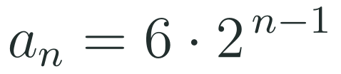
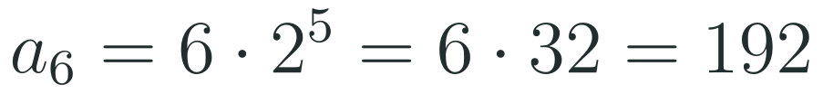
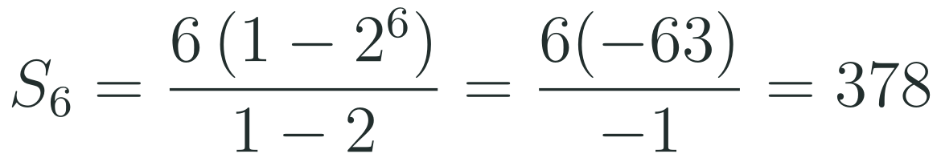
STUDY THIS · ONE EXAMPLE
One Example, Every Step Shown
For 6, 12, 24, and so on: find the 6th term and the sum of the first 6 terms. Cover the right-hand column, try it, then check.
Name the first term, then divide a term by the one before it to find the common ratio.
1
Write the explicit formula: the power is the term number minus 1, because the first term has not been multiplied yet.
2
Substitute the term number 6, so the power is 5. Check: 6, 12, 24, 48, 96, 192.
3
Sum of the first 6 terms with the sum formula. Here the power is the number of terms, 6. Check by adding: 378.
4
The mistake most people make: using the term number as the power. For the 6th term that gives 384, which is really the 7th term: the power is one less than the term number.
HSA.SSE.B.4 · HSF.IF.A.3 · HSF.BF.A.2 · HSF.LE.A.2
FAITH, RIGHTEOUSNESS AND WISDOM
Mr Malek Thiab · Page 3 of 4
Notes:
Speaker notes: Worked solution. Step 1: first term 6, ratio 12 / 6 = 2 (check 24 / 12 = 2). Step 2: explicit formula, a sub n = 6 times 2 to the power n minus 1. Step 3: a sub 6 = 6 times 2 to the power 5 = 6 times 32 = 192; check by doubling: 6, 12, 24, 48, 96, 192. Step 4: S sub 6 = 6 (1 - 64) / (1 - 2) = 6 (-63) / (-1) = 378; check by adding 6 + 12 + 24 + 48 + 96 + 192 = 378. Verbal misconceptions: using the term number as the power gives 6 times 2 to the power 6 = 384, which is the 7th term; adding 6 each time gives 36; answering 192 when the sum is asked. Adaptive routing: if most students miss the power, list the first six terms beside the formula in Diagnose; if they confuse a term with a sum, show 192 against 378.

Slide 4


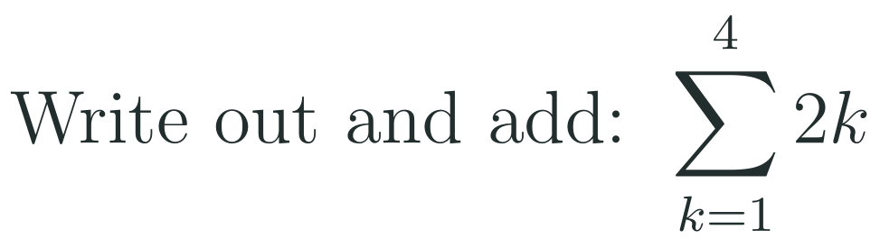
READINESS CHECK · 3 MINUTES
Four Questions: Answer Before Class
This is not graded. It tells me what to teach first. An honest answer helps you more than a lucky one.
1
HOW TO SUBMIT
Type your four answers into the LMS form, one line each.
If you are stuck on one, write “not sure yet” and say what confused you. That is a useful answer.
Due: before the bell. It takes three minutes.
2
3
4
In one sentence: how can you tell a geometric sequence from an arithmetic one?
In class we start with: an 8-question Wayground kick-off on exactly these ideas: exponent rules, the common ratio from terms and from a graph, sigma notation and the sum formula. Then we write formulas for geometric sequences.
HSA.SSE.B.4 · HSF.IF.A.3 · HSF.BF.A.2 · HSF.LE.A.2
FAITH, RIGHTEOUSNESS AND WISDOM
Mr Malek Thiab · Page 4 of 4
Notes:
Speaker notes: Answers. Q1: r = 40 / 80 = 1/2 (divide, do not subtract). Q2: 3 to the power 4 = 81 first, then 2 times 81 = 162. Q3: 2 + 4 + 6 + 8 = 20. Q4: a geometric sequence multiplies by the same number each step (a common ratio); an arithmetic sequence adds the same number (a common difference). Verbal misconceptions: Q1 answering -40; Q2 answering 6 to the power 4 = 1296; Q3 answering 2 times 10 = 20 is fine but 2k read as k squared is not. Adaptive routing: if more than 30 percent miss Q1, start Diagnose with 7, 11, 15 against 3, 6, 12; if more than 30 percent miss Q2, spend two minutes on powers; if most miss Q3, write out k = 1 to 4 in a table.

